Slide 1
National Pollinator Week 2020
Sustainabilibee Moment
Your name
Your title
Your Faculty/Department Name
Date of your sustainability moment

Slide 2
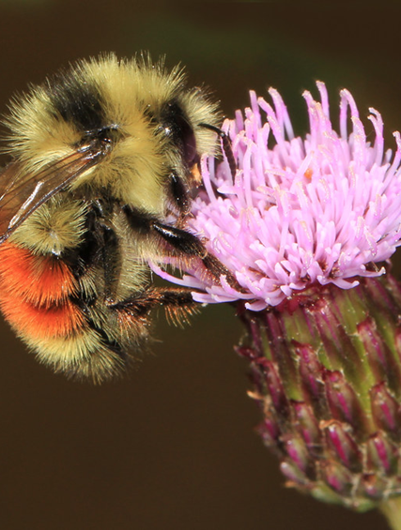
Why are pollinators important?
90% of flowering plants rely on pollinators to reproduce – and so do nearly 75% of the world's crops
Flowering plants produce food, stop soil erosion, and sequester carbon
  Pollinators keep us and our ecosystems healthy!

Slide 3
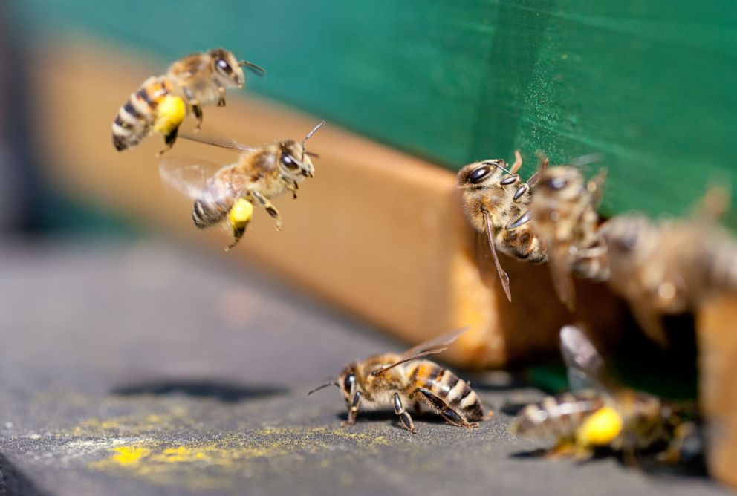
Why are pollinators threatened?
Due to habitat loss, pesticide use, climate change, and competition from non-native honeybees, many native Alberta bee populations are in decline

Slide 4
How can we support pollinators?
Garden with native pollinators in mind
Plant a variety of flower types, shapes and colours, plan for blooms all season long, and avoid pesticide use
If you have a "bee hotel" or box, clean and disinfect the cells every spring once bees have emerged
Visit UCalgary's Bee Campus site to learn more about our recent certification as a Bee City Canada Campus, and use our Digital Collection to learn about the species diversity of native Albertan bees
Follow the Office of Sustainability on Facebook and Instagram (@ucalgarysustain) and celebrate pollinators all week long!
Notes:
Learn more:
Alberta Native Bee Council, “Bumble Bees of Southern Alberta”: https://www1.agric.gov.ab.ca/$Department/deptdocs.nsf/all/prm13779/$FILE/bombus_guide.pdf
Calgary Beekeeper’s Association, “How to Help Bees and Other Pollinators”: https://www.calgarybeekeepers.com/wp-content/uploads/2018/12/How-to-Help-Bees-and-other-Pollinators-3.pdf

Slide 5
Why are bees important to you?
Tell us your office's pollinator story. Send the Office of Sustainability an email at sustain@ucalgary.ca!

